Slide 1
COVID-19 Vaccination programme
Acknowledgments to PHE for use of their training slides
These slide are provisional – Subject to revision
Provisional – Subject to revision – Use latest version link: x

Slide 2
Note to immunisers
This slide set contains a collection of core slides for use during the delivery of COVID-19 immunisation training. Immunisers should select the slides required depending on their background and experience, according to the role they will have in delivering the COVID-19 vaccine programme.
The information in this slide set was correct at time of publication. As COVID is an evolving disease, a lot is still being learned about both the disease and the vaccines which have been developed to prevent it and the knowledge base is still being developed. For this reason, some of the information may change. Updates will be made to this slide set as new information becomes available. Please check online to ensure you are accessing the latest version. The slide set will be updated data as information changes between republications of this slide set.
Slides containing vaccine specific details (such as storage and reconstitution) on the first COVID-19 vaccine to receive regulatory approval have been added to the end of this slide set. Details for other vaccines will be added here as they receive regulatory approval. They are available at the end of the slide set so that trainers can specifically select those they need for the vaccine they are providing training about.
Notes:
Further information on the SARS-Cov-2 virus and COVID-19 disease, epidemiology and the currently authorised vaccines in the COVID-19 chapter of the Green Book.

Slide 3
Content
Learning objectives, pre-requisites, key messages and introduction
International and UK COVID-19 timeline
Coronavirus
COVID-19 epidemiology
Developing a COVID-19 vaccine and vaccination programme
Introducing a new vaccination programme
COVID-19 vaccination programme
Vaccine specific information

Slide 4
Learning objectives
By the end of this session, you should be able to:
explain what COVID-19 is and be aware of the UK epidemiology
understand the policy behind the COVID-19 vaccination programme
describe how vaccines are developed and trialled
identify the groups who are at high risk of COVID-19 infection and who should be prioritised to receive the COVID-19 vaccine

Slide 5
Pre-requisites to administering Covid 19 vaccine
Before administering Covid-19 vaccine, it is recommended you:
have undertaken training in the management of anaphylaxis and Basic Life Support as specified by policy for your local area and are familiar with Resuscitation Council UK (RCUK) guidance on Management of Anaphylaxis in the Vaccination Setting
have undertaken any additional statutory and mandatory training as required by your employer
have received COVID-19 vaccine training through attending a taught session and/or the eLearning for Healthcare COVID-19 vaccine e-learning programme
have received practical training in COVID-19 vaccine preparation and administration
have completed the COVID-19 vaccinator competency assessment tool
have an understanding of the legal mechanisms by which immunisers can supply and administer COVID-19 vaccine
have an appropriate legal framework to supply and administer COVID-19 vaccine in place e.g. patient specific prescription, Patient Specific Direction (PSD), Patient Group Direction (PGD) or Protocol and be able to recognise the differences between these and understand which staff can use each of these
be able to describe the process of consent and how this applies when giving vaccines
accessed and familiarised yourself with the following key documents: Green Book COVID-19 chapter and the PHA Healthcare professional factsheet COVID-19 immunisation programme

Slide 6
Key messages
the ongoing global COVID-19 pandemic continues to cause millions of infections and over a million deaths across the world
a vaccine to prevent COVID-19 is the most effective way to control the pandemic
scientists across the world have worked to develop vaccines which have then been rigorously tested for safety and efficacy
it is crucial that the COVID-19 vaccine is safely and effectively delivered to as many of those eligible as possible
those with a role in delivering the COVID-19 vaccine programme need to be knowledgeable, confident and competent in order to promote confidence in the vaccination programme and deliver the vaccine safely
Notes:
https://coronavirus.jhu.edu/map.html

Slide 7
Introduction
a new virus emerged in Wuhan, China during December 2019
this virus, which causes respiratory disease, was identified as being part of the Coronavirus family and it rapidly spread to many other countries around the world
by 01/12/20, 1,643,086 people had tested positive for the virus and 59, 051 people had died within 28 days of a positive test in the UK
common symptoms of COVID-19 include a high temperature, a continuous dry cough and loss or change to sense of smell and taste
about 80% of infected people have no or mild symptoms; 1 in every 6 people who gets COVID-19 becomes seriously ill
older people and those with underlying medical problems are more likely to develop serious illness or die from COVID-19
measures to contain the virus have included the introduction of social distancing measures, travel restrictions, closure of public spaces and the wearing of face coverings
despite these measures, the number of positive cases and deaths continue to increase on a daily basis
The PHA COVID-19 Bulletin presents high level data on key areas currently being used to monitor COVID-19 activity and highlights current issues and public health messages, along with the analysis of the demographic characteristics (age, sex, geographical location, deprivation) of people affected by the virus and can be accessed here
https://www.publichealth.hscni.net/publications/coronavirus-bulletin
Notes:
Latest data can be obtained from https://coronavirus.data.gov.uk/

Slide 8
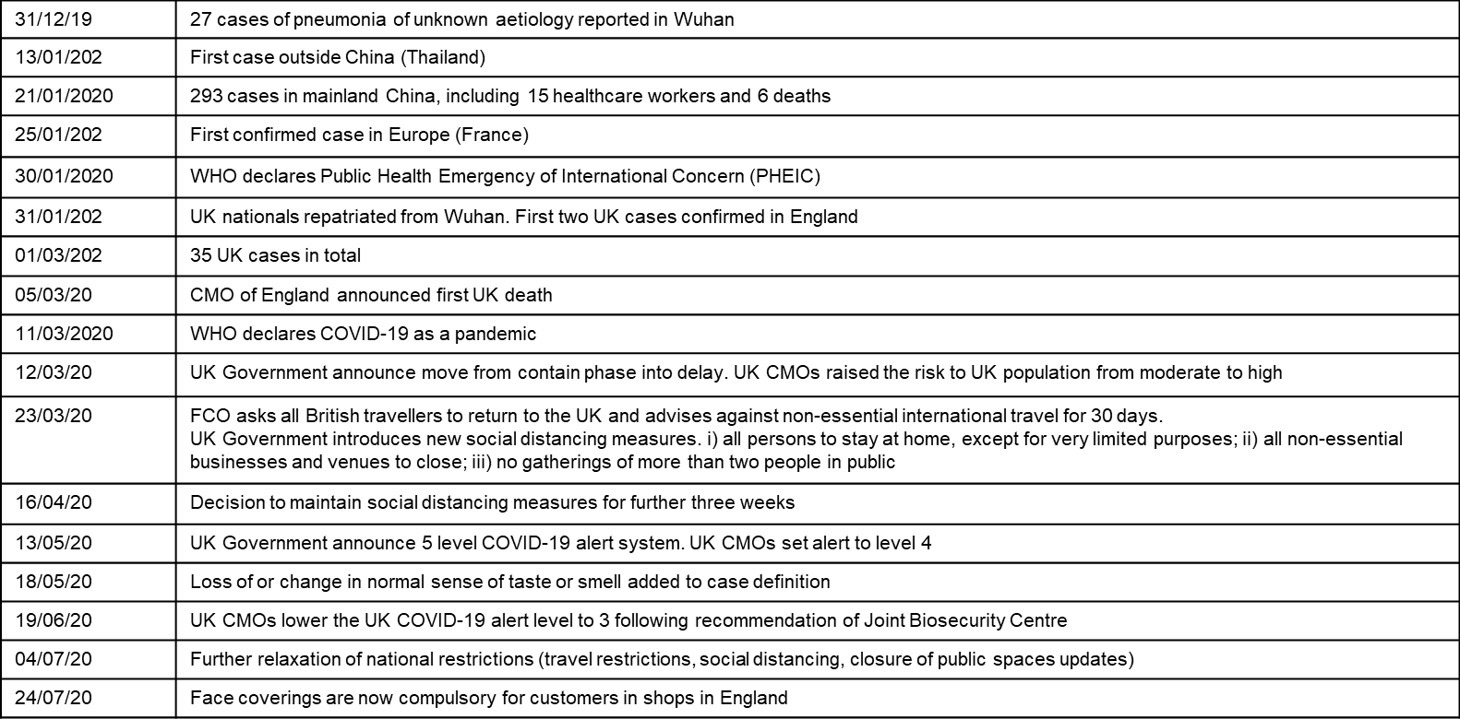
International and UK Covid–19 timeline – the first 7 months
The date of the first positive COVID-19 case in NI was 26/02/2020
The date of the first COVID -19 death in NI (as reported on the mortality reporting system) was 18/03/2020.
Note the definition for these deaths are those who have died within 28 days of a positive specimen

Slide 9
COVID-19 and Coronavirus
COVID-19 is the disease that is caused by infection with the SARS-CoV-2 virus which belongs to the Coronavirus family
      - SARS-CoV-2 stands for Severe Acute Respiratory Syndrome (SARS) and CoV for coronavirus
      - COVID-19 stands for Coronavirus Disease and 19 is from the year 2019 when it was first seen
Coronaviruses may cause illness in animals or humans and they are responsible for causing infections ranging from the common cold to more severe disease such as Severe Acute Respiratory Syndrome (SARS) and Middle East Respiratory Syndrome (MERS) which have been responsible for two outbreaks during the last twenty years
SARS-CoV-2 virus is the most recently discovered coronavirus and has now affected many countries globally
because of the global spread and the substantial number of people affected, the World Health Organisation (WHO) declared COVID-19 as a pandemic on 11/03/2020 (Pan (all) demos (people))

Slide 10
Viral infection
viruses are much smaller than bacteria and consist of a small amount of either DNA or RNA surrounded by a protein coat called a capsid
viruses cannot replicate themselves, but need to seek out the replication mechanism contained within a host cell
examples of vaccine preventable viral diseases include measles, mumps, rubella, influenza, hepatitis A and B
Influenza viruses, which are RNA viruses, are constantly mutating into slightly different forms, which is why we need to produce and give different flu vaccines every year
SARs-CoV-2 is an RNA virus

Slide 11
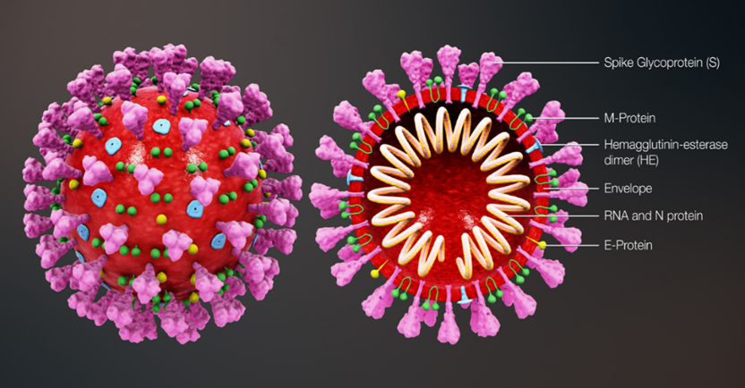
Coronavirus structure
the key parts of the coronavirus are the RNA and the spike proteins
the RNA is surrounded by an envelope which has different roles in the life cycle of the virus. These may include the assembly of new virus and helping new virus to leave the infected cell
the spike proteins (S) are anchored into the viral envelope and form a crown like appearance, like the solar corona, hence the name coronavirus. The spike proteins attach to the target cell and allow the virus to enter it
the RNA is inside the envelope and acts as a template so that once it is inside the host cell, the coronavirus can replicate itself and be released into the body
the Spike protein and the RNA have been used to develop and make different vaccines to protect against SARs-CoV-2
Notes:
Diagram of coronavirus virion structure showing spikes that form a "crown" like the solar corona, hence the name
https://commons.wikimedia.org/wiki/File:3D_medical_animation_coronavirus_structure.jpg

Slide 12
Transmission of COVID-19 infection
For transmission to occur, the SARs-CoV-2 virus needs to be transported to a susceptible person. To do this, it needs to have:
a portal of exit (from the place where it is living and replicating)
a mode of transmission (such as coughing or sneezing) and
a portal of entry (to the susceptible host)
COVID-19 spreads primarily from person to person through small droplets from the nose or mouth which are expelled when a person with COVID-19 coughs, sneezes, or speaks.
These droplets can also survive on objects and surfaces such as tables, doorknobs and handrails.
People can catch COVID-19 if they breathe in these droplets from a person infected with the virus or
by touching contaminated objects or surfaces, then touching their eyes, nose or mouth.

Slide 13
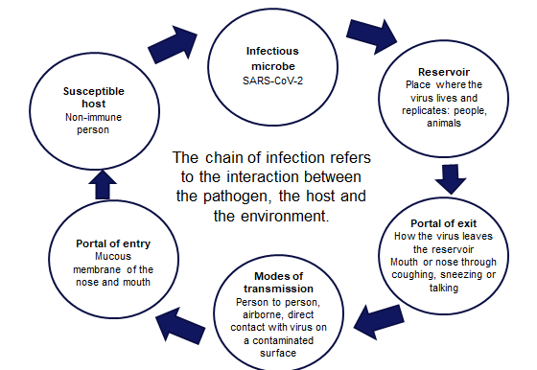
COVID-19 Chain of infection

Slide 14
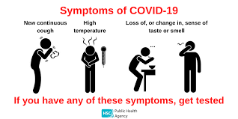
COVID-19 Symptoms
The estimated incubation period is 3 to 6 days but can vary between 1 and 11 days.
Symptoms may vary by age but the main symptoms of coronavirus are:
a new, continuous cough – coughing for more than an hour, or 3 or more coughing episodes in 24 hours
a high temperature
a loss or change to sense of smell or taste
Other symptoms reported include:
fatigue and lethargy
shortness of breath
headache
sore throat
aching muscles
diarrhoea and vomiting

Slide 15
COVID-19 symptom progression
Symptoms may begin gradually and are usually mild.
the majority of people (around 80%) have asymptomatic to moderate disease and recover without needing hospital treatment
around 15% may get severe disease including pneumonia
  older people and those with underlying medical problems such as high blood pressure, heart and lung problems, diabetes, or cancer are more likely to develop serious illness
around 5% become critically unwell. This may include septic shock and/or multi-organ and respiratory failure
The infection fatality rate (the proportion of deaths among all infected individuals) is estimated to be
0.9% but it varies according to age and sex. It is lower in younger people (0.5% for those 45-64
years) and higher in those over 75 years of age (11.6%)
Notes:
https://www.bmj.com/content/bmj/368/bmj.m800.full.pdf

Slide 16
Complications of Covid-19 disease
Complications from COVID-19 can be severe and fatal.
The risk of developing complications increases with age and is greater in those with underlying
health conditions.
The type of complication that can develop may include:
venous thromboembolism
heart, liver and kidney problems
neurological problems
coagulation (blood clotting) failure
respiratory failure
multiple organ failure
septic shock
Notes:
https://bestpractice.bmj.com/topics/en-us/3000168/complications

Slide 17
COVID-19 complications in pregnancy
maternal morbidity is similar to that of other women of reproductive age and the outcome for women infected during pregnancy is usually good
however, pregnant women with pre-existing comorbidities such as chronic hypertension or diabetes, those with higher maternal age, and high body mass index may experience severe COVID-19 disease
they may also require intensive care unit admission and invasive ventilation and around 6% of pregnant women may experience a spontaneous pre-term delivery
neonates born to mothers with COVID-19 have an increased risk of admission to a neonatal unit
although stillbirths have been reported, perinatal deaths are rare and occur in less than 1% of cases
Notes:
https://bestpractice.bmj.com/topics/en-us/3000168/complications
https://www.bmj.com/content/370/bmj.m3320

Slide 18
Symptoms in children and young people
children comprise only 1 to 2% of cases of COVID-19 worldwide and are more likely to have mild symptoms or asymptomatic infection
a study of children and young people aged less than 19 years admitted to hospital with laboratory confirmed SARS-CoV-2 reported that the median age of those enrolled in the study was 4.6 years
other clinical features included age, sex and ethnicity: 35% (225/651) of them were under 12 months old; 56% (367/650) were male; 57% (330/576) were white; 12% (67/576) were South Asian and 10% (56/576) were Black
of the 651 children and young people in the study, 42% had at least one other medical condition (co-morbidity). These included neurological conditions (11%), haematological, oncological or immunological conditions (8%) and asthma (7%)
Notes:
In one study, 11% of children and adolescents presented with fatigue, headache, myalgia, sore throat, lymphadenopathy and a low platelet count.
Clinical characteristics of children and young people admitted to hospital with covid-19 in United Kingdom: prospective multicentre observational cohort study
Olivia V Swann,1,2 Karl A Holden,3,4 Lance Turtle,5,6 Louisa Pollock,7 Cameron J Fairfield,8 Thomas M Drake,8 Sohan Seth,9 Conor Egan,9 Hayley E Hardwick,5 Sophie Halpin,10 Michelle Girvan,10 Chloe Donohue,10 Mark Pritchard,11 Latifa B Patel,12 Shamez Ladhani,13,14 Louise Sigfrid,15 Ian P Sinha,3,12 Piero L lliaro,15 Jonathan S Nguyen-Van-Tam,16,17 Peter W Horby,15 Laura Merson,15 Gail Carson,15 Jake Dunning,18,19 Peter J M Openshaw,19 J Kenneth Baillie,20,21 Ewen M Harrison,8 Annemarie B Docherty,8,21 Malcolm G Semple,4,5

Slide 19
Complications from COVID-19 in children and young people
an extremely rare but severe multisystem inflammatory syndrome (MIS-C) occurring 2 to 4 weeks after the onset of COVID-19 has been identified in children and adolescents
cardiac complications were documented in 57% (21/37) of MIS-C cases. These were more frequent in post-acute / antibody positive cases (75% 15/20) than in the acute phase 35% (6/17)
of the children admitted to hospital, 18% required critical care. This was associated with:
  - age, particularly for those less than one month old and for those age 10 -14 years
  - black ethnicity and
  - admission to hospital for more than five days before symptom onset
other complications from COVID-19 in children and young people include fever, cardiac symptoms (myocarditis, heart failure) and GI symptoms (abdominal pain, diarrhoea, vomiting)
Notes:
MIS-C shares features with Kawasaki disease and toxic shock syndrome and can present in both the acute and convalescent phases of COVID-19 infection.
https://bestpractice.bmj.com/topics/en-us/3000168/complications

Slide 20
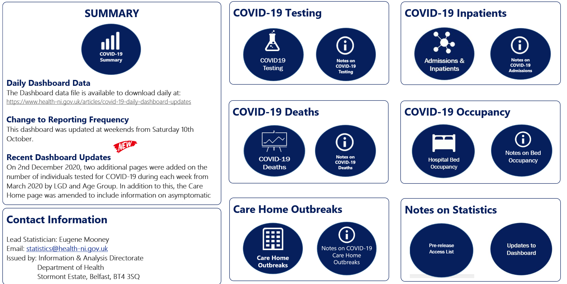
Coronavirus (COVID-19) epidemiology
The current NI epidemiology can be seen on the Department of Health Website at: https://www.health-ni.gov.uk/
Notes:
The current UK epidemiology can be seen on the GOV.UK website at: https://coronavirus.data.gov.uk/

Slide 21
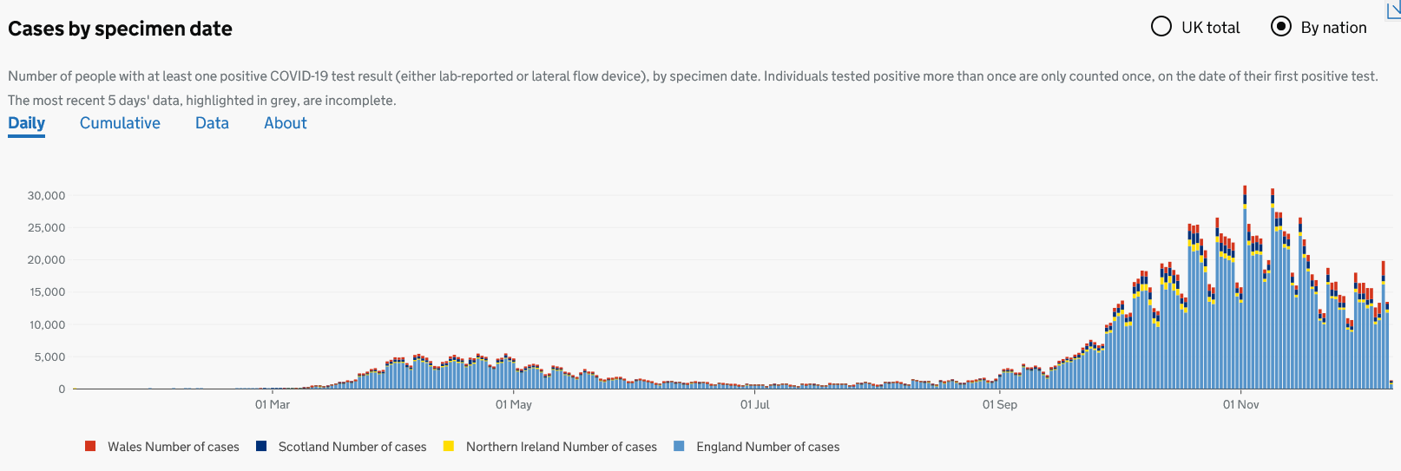
UK Coronavirus (Covid-19) positive tests by nation
1,787, 783 people tested positive for Coronavirus (COVID-19) in the UK between 14/01/2020 and 10/12/2020
Notes:
Early cases were first seen at the end of January and over February, the majority of which were imported. Numbers were low until the end of February with most associated with travel from Europe. From early March case numbers had started to increase exponentially, and social distancing measures had been introduced. Advice from 12 March (week 11) introduced measures such as self-isolation of those with symptoms and cancelling school trips. Enforceable social distancing measures were introduced from 23 March (week 13) and included school closures and remaining indoors.
https://coronavirus.data.gov.uk/details/cases
Number of COVID Tests in NI between 14/01/2020 – 10/12/2020 (by date of specimen) = 732518
Number of positive COVID Tests in NI between 14/01/2020 – 10/12/2020 (by date of specimen) = 57198
*only includes positive, negative and indeterminate results. Deduplication period = 42 days.

Slide 22
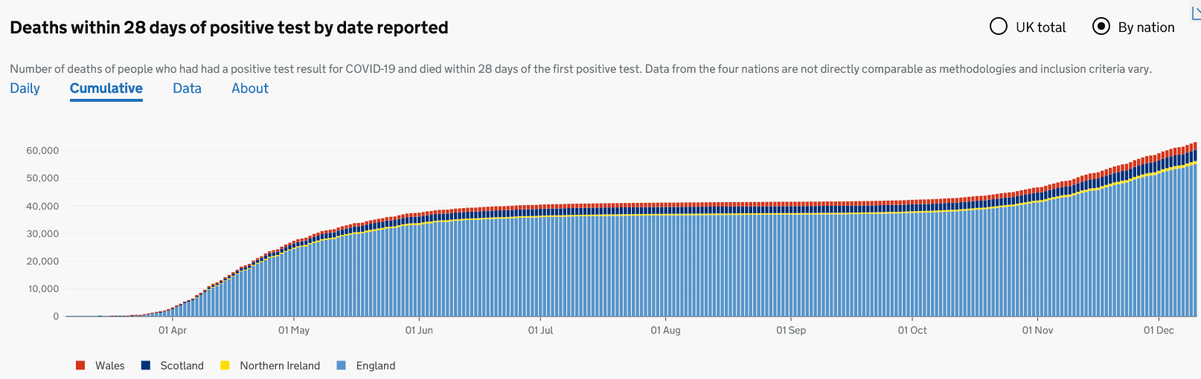
UK deaths within 28 days of a positive test
63,082 deaths within 28 days of a positive test by date of death were recorded between 05/03/2020 and 10/12/2020
Notes:
https://coronavirus.data.gov.uk/details/deaths
Number of COVID-19 deaths in NI between 05/03/2020 – 10/12/2020 (by date of death) =1111
tested positive for SARS-CoV-2 within 28 days of date of death

Slide 23
COVID-19 vaccine taskforce
as the majority of the population are still susceptible (non-immune) to the SARS-CoV-2 virus and the virus spreads easily, it is clear that a safe and effective vaccine is needed to prevent further cases
a COVID-19 vaccine prepares the immune system so that in the event of an exposure to the virus, it is able to respond and prevent or reduce the severity of infection
during April 2020, a UK vaccine taskforce was set up to support the development of a SARS-CoV-2 vaccine
the taskforce supported research and industry to rapidly develop and scale up the manufacture of a vaccine to protect the population

Slide 24
COVID-19 vaccine development
scientists, industry and other organisations have worked collaboratively across the globe to complete the different phases of vaccine development in parallel, rather than sequentially to make a safe and effective vaccine available as soon as possible
by knowing the genetic code for the SARS-CoV-2 virus, various methods to create vaccines can be used such as using the code itself (mRNA vaccines) or inserting part of this code into existing viruses (viral vector vaccines)
by December 2020, over 270 different COVID-19 vaccines were in early development, over 50 of these were being given to people in clinical trials and 11 were being trialled in large phase 3 trials
some vaccines have been made using currently used vaccine technology, others have been made using new approaches or methods used during previous emergencies such as the SARS pandemic and west African Ebola
Notes:
For more information about COVID vaccines in development, see the LSHTM COVID-19 vaccine tracker https://vac-lshtm.shinyapps.io/ncov_vaccine_landscape/

Slide 25
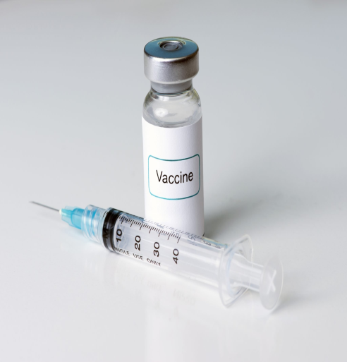
Properties of an ideal vaccine
Ideally, a vaccine will:
produce the same immune protection which usually follows natural infection but without causing disease
generate long lasting immunity so that the person is protected if they are exposed to the antigen several years after vaccination
interrupt the spread of infection by preventing carriage of the organism in the vaccinated person
Vaccines need to be safe and the risk from any side effects should be much lower than the benefit of preventing
deaths and serious complications of the disease.
For the COVID-19 vaccines, many of these properties can be confirmed from the clinical vaccine trials.
Longer term ongoing surveillance of the disease and of those vaccinated will show whether:
vaccine protection is long lasting or booster or annual doses are needed
the vaccine prevents a vaccinated person from carrying and spreading the virus

Slide 26
Stages of vaccine trials
Vaccines are extensively tested through several different phases of trials.
pre-clinical studies using tissue-culture, cell-culture or animal studies. At this stage, safety and immunogenicity (the ability of the vaccine to produce an immune response) are assessed. If pre-clinical studies are successful, the vaccine then goes through several different phases of vaccine trials in humans
phase I clinical trials are small-scale trials in healthy adult volunteers (generally 20-100) to assess whether the vaccine is safe in humans and type and extent of immune response it induces
phase II clinical trials are larger (several hundred healthy volunteers) and usually carried out in the target age group(s) the vaccine is likely to be used in. They are looking mainly to assess the efficacy of the vaccine against artificial infection and clinical disease. Vaccine safety, side-effects and immune response are also studied
phase III clinical trials involve the vaccine being studied on a large scale in many hundreds or thousands of subjects across several sites to evaluate efficacy under natural disease conditions and make sure that there are no unintended side effects not detected in phase II studies

Slide 27
Safety
before any of the COVID vaccines can be authorised for widespread use in the population, the manufacturers have to demonstrate that they are safe and effective
tens of thousands of people across the world have already received COVID-19 vaccines in clinical trials
no serious adverse reactions to the vaccines were seen in the trial participants who received them
any reactions reported were similar to those seen following other vaccines such as pain and tenderness at the injection site and fever, headache, muscle aches and fatigue

Slide 28
Effectiveness
manufacturers of the COVID-19 vaccines need to show evidence that they will be effective
they can do this by showing a reduction in virus levels in animal studies where the vaccines were used and that people in the trials have made an antibody response to the vaccine
vaccine effectiveness can be calculated by comparing the number of cases of COVID-19 disease in trial participants who received the COVID-19 vaccine with the number of trial participants who received the placebo or alternative (non-COVID-19) vaccine
Those running clinical trials will also look at antibody response:
      - after one dose and two doses
      - at different dosages of the vaccine
      - with different time intervals between vaccine doses
      - in different age groups
Over time, they will look at
how long the antibodies last and the effect on antibody levels if a booster dose is given.
whether the vaccine only stops people from becoming severely ill or if it also stops them spreading the virus too

Slide 29
Regulatory approval and licencing
in the UK, vaccine manufacturers apply to the Medicines and Healthcare products Regulatory Agency (MHRA) or the European Medicines Agency (EMA) for a product licence but they may issue a temporary authorisation ahead of the full UK product licence
in exceptional situations, the MHRA may enact Regulation 174. This enables them to temporarily authorise the supply of an unlicensed medicinal product in response to certain identified public health risks, such as the SARS-CoV-2 pandemic
the MHRA assess all of the available safety, quality and efficacy data and considers whether the evidence supports the use of the medicine or vaccine under the legal basis of regulation 174 until it can be licensed
the process involves the same level of scrutiny as the usual licensing process and this exception is only used when strictly necessary to speed up access to a potentially life-saving intervention

Slide 30
Post authorisation surveillance
On-going studies of vaccines continue after the vaccine has been authorised for use.
These studies aim to assess long term efficacy and to detect any rare adverse effects
because in real life administration, compared to pre-licensure trials, there will be:
some variability in preparation of the vaccine as vaccines will come from different batches
possible variability in stability and storage, for example the cold chain may not be as rigidly maintained in practice as it was in a clinical trial
use of the vaccines in different groups than in pre-license studies, for example they will be given to people with underlying medical conditions who would not necessarily have been included in a pre-licensure clinical trial

Slide 31
COVID-19 Vaccines
On 2 December 2020, the following vaccine was given authorisation for temporary supply by the UK DHSC and the MHRA:
COVID-19 mRNA Vaccine BNT162b2 (Pfizer-BioNTech) is a messenger ribonucleic acid (mRNA) that contains the genetic sequence of the antigens found on the surface of the SARS-CoV-2 virus
On 30 December 2020, the following vaccine was also authorised for temporary supply in the UK:
AstraZeneca COVID-19 vaccine which is a non-replicating viral vector vaccine. It uses a weakened adenovirus as a carrier to deliver the genetic sequence for part of the SARS-CoV-2 virus into the body

Slide 32
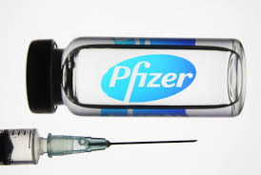
COVID-19 MRNA vaccine BNT162B2 (Pifzer BioNtech)
The COVID-19 mRNA Vaccine BNT162b2 vaccine is a messenger ribonucleic acid (mRNA) vaccine.
It contains the genetic sequence (mRNA) for the spike protein which is found on the surface of the SARS-CoV-2 virus, wrapped in a lipid envelope (referred to as a nanoparticle) to enable it to be transported into the cells in the body.
When injected, the mRNA is taken up by the host’s cells which translate the genetic information and produce the spike proteins.
These are then displayed on the surface of the cell. This stimulates the immune system to produce antibodies and activate T-cells which prepare the immune system to respond to any future exposure to the SARS-CoV-2 virus by binding to and disabling any virus encountered.
As there is no whole or live virus involved, the vaccine cannot cause
disease. The mRNA naturally degrades after a few days.

Slide 33
AstraZeneca COVID-19 vaccine
AstraZeneca COVID-19 vaccine is a viral vector vaccine which uses a weakened adenovirus as a carrier to deliver the SARS-CoV-2 antigen.
The adenovirus has been modified so that it cannot replicate (grow and multiply by making copies of itself) in human cells and therefore cause any disease.
The genes that encode for the spike protein on the SARS-CoV-2 virus have been inserted into the adenovirus's genetic code to make the vaccine.
When the vaccine is injected, it enters the host's cells which then manufacture the spike protein.
This then stimulates the immune system which reacts by producing antibodies and memory cells to the SARS-CoV-2 virus without causing disease.

Slide 34
Additional COVID-19 vaccines
If more COVID vaccines are considered for authorisation in the UK, information about these will be added to this slide set
Further details about presentation and preparation of the
Pfizer-BioNTech and the AstraZeneca vaccines are available on
slides at the end of this slide set

Slide 35
Vaccine interchangeability
data is not yet available on the interchangeability of different COVID-19 vaccines
therefore, every effort should be made to determine which vaccine the individual received and to complete with the same vaccine
for individuals who started the schedule and who attend for vaccination at a site where the same vaccine is not available, or where the first product received is unknown, it is reasonable to offer a single dose of the locally available product
this option is preferred if that individual is likely to be at immediate high risk or is considered unlikely to attend again
as the Pfizer-BioNTech BNT162b2 vaccine and the AstraZeneca vaccine are both based on the spike protein of the virus, it is likely that the second dose will help to boost the response to the first dose
further doses of vaccine are not required unless additional information becomes available

Slide 36
Key factors that inform UK vaccination policy
The Joint Committee on Vaccines and Immunisation (JCVI) consider the following before making vaccination policy recommendations to the Department of Health and Social Care (DHSC) and Devolved Administration Governments:
Availability of a safe and effective vaccine:
  - there are currently over 270 COVID-19 vaccines in development and being trialled
  - vaccines undergo extensive and vigorous testing before they are licensed and authorised for use as they have to be able to demonstrate quality, efficacy and safety
Whether there is a need for a vaccination programme;
  - SARS-CoV-2 has caused a significant public health problem, transmission is widespread and has been sustained despite various interventions
  - the virus affects all age groups and there have been frequent outbreaks in nursing and residential homes, schools and communities
  - there is significant morbidity and mortality in certain groups. There are multi-system complications from having the disease and there have been tens of thousands of deaths from COVID-19 in the UK
Notes:
Note: In England it is a legislative requirement for DHSC to fund and implement a JCVI recommended vaccine programme
It is not a legislative requirement for the other devolved administrations but to date in NI no JCIV recommended programme has not been implemented

Slide 37
Designing and implementing a vaccination programme in England
Other national bodies involved in the design and implementation of vaccination programmes:
the Department of Health and Social Care (DHSC) is responsible for vaccine policy decisions and finance for vaccine programmes
the Medicines and Healthcare products Regulatory Agency (MHRA) is responsible for independent oversight of all aspects of vaccine manufacture and regulation including the licensing of vaccines and the Yellow Card adverse event reporting scheme
Public Health England (PHE) is responsible for the national planning, leadership, procurement and supply of vaccines used for the national vaccination schedule and for on-going surveillance to inform the programmes
the National institute for Biological Standards and Control (NIBSC) is responsible for evaluating the quality and biological activity of vaccines and for official batch release testing as required by EU law before release
NHS England is responsible for the commissioning, implementation and delivery of immunisation programmes through local teams.
Notes:
National or local Public Health organisations then make arrangements to implement the policy agreed and funded by the government based on JCVI advice – here in NI DOH
Public Health Agency is responsible for planning, implementing and monitoring immunisation programmes in Northern Ireland and ongoing disease surveillance to inform the programmes.
Delivery is then via health service Trusts or Primary Care practitioners

Slide 38
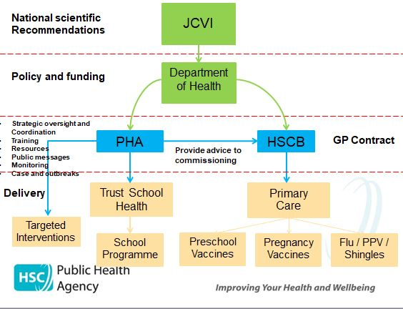
Designing and implementing a vaccination programme in Northern Ireland
Notes:
the Department of Health NI (DH) is responsible for vaccine policy decisions, finance for vaccine programmes and procurement of national vaccines
Public Health Agency (PHA) – Health Protection is responsible for the national planning, leadership and for on-going surveillance to inform the programmes
HSCB Integrated Care is responsible for the commissioning, implementation and delivery of immunisation programmes through GP practices
PHA Nursing - is responsible for school nursing commissioning
Regional Procurement Pharmacy Service is responsible for distribution and supply of vaccines
Vaccine safety monitoring is UK level ie.
the Medicines and Healthcare products Regulatory Agency (MHRA) is responsible for independent oversight of all aspects of vaccine manufacture and regulation including the licensing of vaccines and the Yellow Card adverse event reporting scheme
the National institute for Biological Standards and Control (NIBSC) is responsible for evaluating the quality and biological activity of vaccines and for official batch release testing as required by EU law before release

Slide 39
Other agencies
Many other agencies have a key role in the design, development and implementation of vaccination
programmes at a national, regional and local level to ensure the key components of a successful
vaccination programme come together.
These components include:
vaccine development
vaccine supply and delivery
surveillance of vaccine coverage
surveillance of population susceptibility to the disease
surveillance of disease in the population
adverse events and vaccine safety surveillance
monitoring attitudes to vaccination
communication
modelling to predicting the future impact of vaccination programmes

Slide 40
COVID-19 vaccine programme considerations
The overall aim of the COVID-19 vaccination programme is to protect those who are at most risk
from serious illness or death.
In order to advise which groups of patients to vaccinate and in which order to prioritise vaccination of
these groups, the JCVI consider all the available relevant information on:
vaccine efficacy and/or immunogenicity and the safety of administration in different age and risk groups
the effect of the vaccine on acquisition of infection and transmission
the epidemiological, microbiological and clinical characteristics of COVID-19
From this, they then make recommendations to the DHSC and planning to deliver vaccine and
maximise uptake in these groups can begin.

Slide 41
Priority groups for COVID-19 vaccination
JCVI have identified provisional priority groups for vaccination
these groups are under regular review and prioritisation may change as more information about the vaccines becomes available
prioritisation will ensure that those at highest risk of severe illness and death are vaccinated early
the priority groups have been selected based on the epidemiology of the infection observed since the start of the pandemic: their risk of severe disease, mortality and other considerations such as ethnicity, deprivation and occupation
evidence from the UK indicates that the risk of poorer outcomes from COVID-19 infection increases dramatically with age in both healthy adults and in adults with underlying health conditions
those over the age of 65 years have by far the highest risk, and the risk increases with age
full details on vaccine eligibility, with detail on the at-risk conditions, are included in the Green Book COVID-19 chapter
Notes:
JCVI advises that the first priorities for the COVID-19 vaccination programme should be the prevention of mortality and the maintenance of the health and social care systems. As the risk of mortality from COVID-19 increases with age, prioritisation is primarily based on age. The order of priority for each group in the population corresponds with data on the number of individuals who would need to be vaccinated to prevent one death, estimated from UK data obtained from March to June 2020

Slide 42
Vaccine priority groups: JCVI advice 30 December 2020
Residents in a care home for older adults and their carers
All those 80 years of age and over
Frontline health and social care workers
All those 75 years of age and over
All those 70 years of age and over
Clinically extremely vulnerable individuals (not including pregnant women and those under the age of 16 years)
All those 65 years of age and over
All individuals aged 16 years to 64 years with underlying health conditions which put them at higher risk of serious disease and mortality
All those 60 years of age and over
All those 55 years of age and over
All those 50 years of age and over
Notes:
JCVI advice 30/12/20 available at :
https://www.gov.uk/government/publications/priority-groups-for-coronavirus-covid-19-vaccination-advice-from-the-jcvi-30-december-2020/joint-committee-on-vaccination-and-immunisation-advice-on-priority-groups-for-covid-19-vaccination-30-december-2020
It is estimated that taken together, these groups represent around 99% of preventable mortality from COVID-19.

Slide 43
Older adults resident in a care home
there is clear evidence that those living in residential care homes for older adults have been disproportionately affected by COVID-19
those living in care homes have a high risk of exposure to infection due to their close contact with staff (including bank staff) and other residents including those residents returning to the care home from hospital
the closed setting of the care home also increases the risk of outbreaks occurring as any asymptomatic residents and staff could be potential reservoirs for on-going transmission
given the increased risk of outbreaks, morbidity and mortality in these closed settings, older adults in care homes are considered to be at very high risk
JCVI have advised that this group should be the highest priority for vaccination
vaccination of residents and staff at the same time is considered to be a highly efficient strategy within a mass vaccination programme with the greatest potential impact
Notes:
https://www.gov.uk/government/statistics/vivaldi-1-coronavirus-covid-19-care-homes-study-report

Slide 44
Older adults
older adults are considered to be at very high risk if they develop COVID-19 infection
current evidence strongly indicates that the single greatest risk of mortality from COVID-19 is increasing age and that the risk increases exponentially with age
disease severity, risk of hospitalisation and mortality increase from age 50 upwards, with the highest risk in those aged 80 years and above
data indicate that the absolute risk of mortality is higher in those over 65 years than that seen in the majority of younger adults with an underlying health condition
Notes:
Current evidence strongly indicates that the single greatest risk of mortality from COVID-19 is increasing age and that the risk increases exponentially with age

Slide 45
Health and Social care Workers
Frontline health and social care workers are at increased personal risk of exposure to infection with COVID-19 and of transmitting that infection to susceptible and vulnerable patients in health and social care settings. As well as the risk to themselves, they can carry and transmit the virus to their families, friends, colleagues and vulnerable patients in health and social care settings (including those in residential and care homes)
this group includes those working in hospice care and those working temporarily in the COVID-19 vaccination programme who provide face-to-face clinical care
the Green Book COVID-19 chapter contains details about the different groups of health and social care workers who may be offered COVID-19 vaccine

Slide 46
Clinically extremely vulnerable
people who are defined as clinically extremely vulnerable are considered to be at very high risk of severe illness from COVID-19
there are two ways an individual may be identified as clinically extremely vulnerable:
- they have one or more of the conditions listed on the GOV.UK website, or
- a hospital clinician or GP has added them to the Shielded patients list because they consider them to be at higher risk of serious illness from COVID-19
many of those who are clinically extremely vulnerable are in the oldest age groups and will be among the first to receive vaccine - the remainder of this group should be offered vaccine alongside those aged 70-74 years of age
the overall risk of mortality for clinically extremely vulnerable younger adults is estimated to be roughly the same as the risk to persons aged 70-74 years
see Green Book COVID-19 chapter for more information about vaccination of this group
Notes:
Many individuals who are clinically extremely vulnerable will have some degree of immunosuppression or be immunocompromised and may not respond as well to the vaccine. Therefore, those who are clinically extremely vulnerable should continue to follow Government advice on reducing their risk of infection. Consideration has been given to vaccination of household contacts of immunosuppressed individuals. However, at this time there are no data on the size of the effect of COVID-19 vaccines on transmission. Evidence is expected to accrue during the course of the vaccine programme, and until that time the JCVI is not in a position to advise vaccination solely on the basis of indirect protection. Once sufficient evidence becomes available the JCVI will consider options for a cocooning strategy for immunosuppressed individuals, including whether any specific vaccine is preferred in this population.

Slide 47
Groups with underlying health conditions
As well as age, other risk factors have been identified that place individuals at risk of serious disease
or death from COVID-19. These include groups with certain underlying health conditions and may
include people who have:
chronic (long-term) respiratory disease
chronic heart disease
chronic kidney disease
chronic liver disease
chronic neurological disease
diabetes
a weakened immune system due to disease or treatment
asplenia or dysfunction of the spleen
morbid obesity (defined as BMI of 40 and above)
severe mental illness
Detailed information giving examples of conditions in each of the clinical risk groups which would
make individuals aged 18 years and over eligible for vaccination is provided in the COVID-19 Green
Book chapter.
Notes:
www.gov.uk/government/publications/priority-groups-for-coronavirus-covid-19-vaccination-advice-from-the-jcvi-25-september-2020/jcvi-updated-interim-advice-on-priority-groups-for-covid-19-vaccination#fn:1
When compared to persons without underlying health conditions, the absolute increased risk in those with underlying health conditions is considered generally to be lower than the increased risk in persons over the age of 65 years (with the exception of the clinically extremely vulnerable).

Slide 48
Pregnancy
although the currently available data do not indicate any safety concerns or harm to pregnancy, there is currently insufficient evidence to recommend the use of COVID-19 vaccines during pregnancy
however, the JCVI has advised that vaccination in pregnancy should be considered where the risk of exposure to SARS-CoV-2 infection is high and cannot be avoided, or where the woman has underlying conditions that put them at very high risk of serious complications of COVID-19
in these circumstances, clinicians should discuss the risks and benefits of vaccination with the woman, who should be told about the absence of safety data for the vaccine in pregnancy
those who are trying to become pregnant do not need to avoid pregnancy after vaccination
if a woman finds out she is pregnant after she has started a course of vaccine, she should complete her pregnancy before finishing the recommended schedule
termination of pregnancy following inadvertent immunisation should not be recommended. Surveillance of inadvertent administration in pregnancy is being conducted by the PHE Immunisation Department Please report inadvertent administration in pregnancy to them (www.gov.uk/guidance/vaccination-in-pregnancy-vip)
Notes:
See https://www.gov.uk/government/publications/safety-of-covid-19-vaccines-when-given-in-pregnancy/the-safety-of-covid-19-vaccines-when-given-in-pregnancy for more information

Slide 49
Breastfeeding
there is no known risk associated with giving non-live vaccines whilst breastfeeding
JCVI advises that breastfeeding women may be offered vaccination with the Pfizer-BioNTech or COVID-19 AstraZeneca vaccines
the developmental and health benefits of breastfeeding should be considered along with the woman’s clinical need for immunisation against COVID-19
the woman should be informed about the absence of safety data for the vaccine in breastfeeding women

Slide 50
Deprivation and ethnicity
there is clear evidence that certain Black, Asian and minority ethnic (BAME) groups have higher rates of infection, and higher rates of serious disease, morbidity and mortality from SARS-Cov-2 infection
there is no strong evidence that ethnicity by itself (or genetics) is the sole explanation for observed differences in rates of severe illness and deaths
certain health conditions are associated with increased risk of serious disease, and these health conditions are often overrepresented in certain BAME groups
societal factors, such as occupation, household size, deprivation, and access to healthcare can increase susceptibility to COVID-19 and worsen outcomes following infection
good vaccine coverage in BAME groups will be the most important factor within a vaccine programme in reducing inequalities for this group
Notes:
https://www.nature.com/articles/s41586-020-2521-4.pdf
The JCVI have advised that NHS England and Improvement, the Department of Health and Social Care, Public Health England and the devolved administrations work together to ensure that inequalities are identified and addressed in implementation. This could be through culturally competent and tailored communications and flexible models of delivery, aimed at ensuring everything possible is done to promote good uptake in Black, Asian and minority ethnic groups and in groups who may experience inequalities in access to, or engagement with, healthcare services. These tailored implementation measures should be applied across all priority groups during the vaccination programme.

Slide 51
COVID-19 mRNA Vaccine BNT162b2 (Pfizer BioNTech)

Slide 52
COVID-19 mRNA Vaccine BNT162b2 (Pfizer BioNTech)
The vaccine contains BNT162b2 messenger RNA embedded in lipid nanoparticles
The vaccine does not contain preservative
No animal products are used in the manufacture of this vaccine
Product information about the COVID-19 mRNA Vaccine BNT162b2 is available at https://coronavirus-yellowcard.mhra.gov.uk/productinformation
Notes:
The vaccine does not contain any animal products

Slide 53
Precautions to COVID-19 mRNA Vaccine BNT162b2
a very small number of individuals have experienced anaphylaxis when vaccinated with the COVID-19 mRNA Vaccine BNT162b2 vaccine
following close surveillance of the initial roll-out, the MHRA has advised that individuals with a history of anaphylaxis to food, an identified drug or vaccine, or an insect sting can receive any COVID-19 vaccine, as long as they are not known to be allergic to a component (excipient) of the vaccine
all recipients of this vaccine should be kept for observation and monitored for a minimum of 15 minutes
facilities for management of anaphylaxis should be available at all vaccination sites
individuals with a localised urticarial (itchy) skin reaction (without systemic symptoms) to the first dose of a COVID-19 vaccine should receive the second dose of vaccine with prolonged observation (30 minutes) in a setting with full resuscitation facilities (e.g. a hospital)
individuals with non-allergic reactions (vasovagal (fainting) episodes, non-urticarial skin reaction or non-specific symptoms) can receive the second dose of vaccine in any vaccination setting
Notes:
Anaphylaxis can be a rare risk of most vaccines and it is important that health professionals are vigilant in watching for the early signs and initiate prompt treatment, as occurred in these cases. The vast majority of people will not be at risk of anaphylaxis after being administered the Pfizer BioNtech vaccine.

Slide 54
Contraindications to COVID-19 mRNA Vaccine BNT162b2
The COVID-19 mRNA Vaccine BNT162b2 vaccine should not be given to people who have had a confirmed anaphylactic reaction to the vaccine or any components of the vaccine
In addition to the highly purified BNT162b2 messenger RNA, the vaccine also contains:
ALC-0315 = (4-hydroxybutyl) azanediyl)bis (hexane-6,1-diyl)bis(2-hexyldecanoate)
ALC-0159 = 2-[(polyethylene glycol)-2000]-N,N-ditetradecylacetamide
1,2-Distearoyl-sn-glycero-3-phosphocholine
cholesterol
potassium chloride
potassium dihydrogen phosphate
sodium chloride
disodium hydrogen phosphate dihydrate
sucrose
water for injections
Polyethylene glycol (PEG) is an allergen commonly found in medicines and also in household goods and cosmetics. Known allergy to PEG is extremely rare but would contraindicate receipt of this vaccine.
The AstraZeneca vaccine does not contain PEG and is a suitable alternative.

Slide 55
Adverse reactions following COVID-19 mRNA Vaccine BNT162b2
The following reactions were reported by the vaccine clinical trial participants
Local reactions
Over 80% reported pain at the injection site. Redness and swelling was also commonly reported
Systemic reactions
The most frequently reported systemic reactions (reactions affecting the whole body) were
tiredness (> 60%) headache (> 50%)
muscle aches (> 30%) chills (> 30%)
joint pain (> 20%) raised temperature (pyrexia)(> 10%)
these symptoms were usually mild or moderate in intensity and resolved within a few days after vaccination.
medicines such as paracetamol can be given for pain or fever if required.
inform vaccinees these symptoms normally last less than a week but if their symptoms get worse or they are concerned, they should speak to their GP

Slide 56
COVID-19 mRNA Vaccine BNT162b2 presentation
the vaccine packs contain 195 vials of vaccine (975 doses per pack as each vial contains 5 doses)
the vaccine is contained in a multidose clear glass vial. The vial has a rubber (bromobutyl) stopper, aluminium seal and a flip-off plastic cap. The stopper does not contain latex
each vial contains 0.45 ml of vaccine and should be diluted with 1.8 ml of Sodium Chloride 0.9% Solution for Injection (normal saline). Once diluted, each reconstituted vaccine will supply 5 doses of 0.3 ml (30 mcg)
Note: after withdrawing 5 full 0.3ml doses from the vial, it may be possible to withdraw a sixth full dose if the dose-sparing needles and syringes being provided with the vaccine are being used. Care should be taken to ensure a full 0.3 mL dose will be administered to the patient from the same vial. Where a full 0.3 ml dose cannot be extracted, the contents should be discarded
a separate ampoule containing a minimum of 2ml of normal saline is required for vaccine reconstitution
each ampoule of diluent is single use and any remaining diluent must be discarded after 1.8 ml has been withdrawn, regardless of the ampoule volume
Notes:
Bromobuty is a synthetic rubber – it does not contain latex so this vaccine is suitable for people with a latex allergy.

Slide 57
COVID-19 mRNA Vaccine BNT162b2 dose and schedule
a single dose is 0.3 ml (30 mcgs)
two doses of COVID-19 mRNA Vaccine BNT162b2 are required with a minimum 21-day interval between doses
operationally, it is recommended that the second dose of COVID-19 vaccine should be routinely scheduled between four and 12 weeks after the first dose
this will allow more people to benefit from the protection provided from the first dose during the roll out phase
longer term protection will then be provided by the second dose

Slide 58
Storage and use of mRNA Vaccine BNT162b2
the mRNA Vaccine BNT162b2 has very specific storage, reconstitution and 'use within' requirements
all those involved in the delivery of the COVID-19 vaccination programme must be aware of the recommended storage requirements, refer to the vaccine product information.
The vaccine must not be given if you are not confident that it has been stored or reconstituted as recommended by the manufacturer or as advised by a vaccine expert
If the vaccine is stored incorrectly:
the vaccines should be labelled and quarantined, the vaccines should not be used until further notice.
breaches in the cold-chain should be reported in line with local arrangements make alternative arrangements for immunisation clinics until resolved
further advice re use should be sought from the local Trust’s Pharmacy Department or Medicines Information Service.
vaccine losses outside of secondary care should be reported to the PHA Duty Room (0300 555 0119) for further risk assessment, including whether patients need revaccination following a cold chain breach.

Slide 59
COVID-19 mRNA Vaccine BNT162b2 reconstitution
The following equipment is required for reconstitution:
one COVID-19 mRNA Vaccine BNT162b2 vaccine multidose vial
one plastic ampoule of Sodium Chloride 0.9% Solution for Injection - this will be supplied in multiple presentations (different manufacturers and different sized ampoules)
an alcohol swab, a green hubbed needle and a 2 ml syringe to reconstitute - needles and syringes will be supplied together in boxes of 100
After dilution the vaccine should be used as soon as is practically possible
Reconstituted vaccine can be stored between +2ºC and +25ºC but must be used within 6 hours following dilution

Slide 60
Reconstituting COVID-19 mRNA Vaccine BNT162b2 (1)
clean hands with alcohol-based gel or soap and water
assemble one ampoule of Sodium Chloride 0.9% Solution for Injection, a single use alcohol swab, a needle with a green hub and a 2ml syringe
from cold storage, remove one vial of vaccine
if removing the multidose vaccine vial directly from a ULT freezer, allow the vaccine to defrost for 30 minutes at temperatures up to 25ºC and reconstitute within 2 hours after thawing
if removing the multidose vaccine vial from cold storage between +2 and +8ºC, check that it has not been stored there for longer than 5 days (120 hours)
when the thawed vaccine is at room temperature, gently invert the vial 10 times prior to dilution. Do not shake
check the expiry date and the appearance of the vaccine. Prior to dilution, the vaccine should be an off-white solution with no particulates visible. Discard the vaccine if particulates or discolouration are present
connect the needle with a green hub to the 2 ml syringe

Slide 61
Reconstituting COVID-19 mRNA Vaccine BNT162b2 (2)
clean the vial stopper with the single use alcohol swab and allow to air dry fully
draw up 1.8 ml of Sodium Chloride 0.9% Solution for Injection, then discard the diluent ampoule and any remaining diluent in it. Do not use any other type of diluent
add diluent to the vaccine vial. You may feel some pressure in the vial as you add the diluent. Equalise the vial pressure by withdrawing 1.8 ml of air into the empty diluent syringe before removing the needle from the vial
Gently invert the diluted solution 10 times. Do not shake
The diluted vaccine should be an off-white solution with no particulates visible. Discard the diluted vaccine if particulates or discolouration are present
Dispose of green hub needle and syringe into yellow sharps bin
The diluted vial should be clearly labelled with the discard time and date
Reconstituted vaccine should ideally be used immediately and must be used within 6 hours following dilution
Notes:
Reconstituted vaccine can be returned to the fridge/cool box and stored between 2oC and 8oC (or up to 25°C if not in fridge) but must be used within 6 hours following dilution.

Slide 62
Reconstituting COVID-19 mRNA Vaccine BNT162b2 (3)
Notes:
Acknowledgements to the BHSCT for use of their image.

Slide 63
COVID-19 mRNA Vaccine BNT162b2 dose preparation
if the vaccine has previously been reconstituted, check that the time of reconstitution was within the last 6 hours
clean top of vial with a single use alcohol swab and allow to air dry fully
unwrap one of the 1ml combined 23g/25mm blue hub needle and syringes provided (recommended needle length depends on body mass of patient. Longer length (38mm) needles are recommended and being supplied for morbidly obese individuals to ensure the vaccine is injected into muscle).
withdraw a dose of 0.3 ml of diluted product for each vaccination. Ensure correct dose is drawn up
any air bubbles should be removed before removing the needle from the vial in order to avoid losing any of the vaccine dose
the same needle and syringe should be used to draw up and administer the dose of vaccine to prevent under dosing of the vaccine to the person
the needle should only be changed between the vial and the patient if it is contaminated or damaged

Slide 64
COVID-19 Vaccine
AstraZeneca

Slide 65
Contraindications to Covid-19 Vaccine AstraZeneca
The COVID-19 Vaccine AstraZeneca vaccine should also not be given to people who have had a confirmed anaphylactic reaction to the vaccine or any components of the vaccine
The COVID-19 Vaccine AstraZeneca contains recombinant, replication-deficient chimpanzee adenovirus vector encoding the SARS‑CoV‑2 Spike (S) glycoprotein.
It also contains:
L-Histidine
L-Histidine hydrochloride monohydrate
Magnesium chloride hexahydrate
Polysorbate 80
Ethanol
Sucrose
Sodium chloride
Disodium edetate dihydrate
Water for injections
The vaccine does not contain preservative

Slide 66
Adverse reactions following Covid-19 Vaccine AstraZeneca
The following reactions were reported by the vaccine clinical trial participants:
Local reactions
More than 60% reported tenderness at the injection site with redness, swelling, pain also being reported
Systemic reactions
The most frequently reported systemic reactions (reactions affecting the whole body) were
        tiredness (> 50%) headache (> 50%)
        muscle aches (> 40%) feeling generally unwell (>40%)
        chills (> 30%) raised temperature (pyrexia)(> 30%)
        joint pain (> 20%) nausea (> 20%)
these symptoms were usually mild or moderate in intensity and resolved within a few days after vaccination
medicines such as paracetamol can be given for post-vaccination pain or fever if required
inform vaccinees these symptoms normally last less than a week but if their symptoms get worse or they are concerned, they should speak to their GP

Slide 67
Covid-19 Vaccine AstraZeneca presentation
COVID-19 Vaccine AstraZeneca is presented in a multidose vial containing a solution which should be colourless to slightly brown, clear to slightly opaque and free of particles
the vial has a halobutyl rubber stopper and is sealed with an aluminium overseal. There is no latex in the vial stopper (bung)
AstraZeneca vaccine will be delivered in packs that contain 10 vials
two different presentations of the AstraZeneca vaccine are expected to be provided:
        80 dose packs (ten 4 ml vials with 8 doses per vial)
        100 dose packs (ten 5 ml vials with 10 doses per vial)
the majority of the vaccine will be supplied as the 8 doses per vial presentation but the 10 dose vial may be provided initially
Vaccinators must check how many doses the vial they are using contains so that vaccine is not wasted

Slide 68
Covid-19 Vaccine AstraZeneca dose and schedule
a single dose is 0.5ml
two doses of AstraZeneca vaccine are required with a minimum 28-day interval between doses
operationally, it is recommended that the second dose of COVID-19 vaccine should be routinely scheduled between four and 12 weeks after the first dose
this will allow more people to benefit from the protection provided from the first dose during the roll out phase
high levels of protection are evident after the first dose of vaccine
longer term protection will then be provided by the second dose

Slide 69
Covid-19 Vaccine AstraZeneca storage and use
upon delivery, AstraZeneca vaccine should be transferred to a fridge immediately and stored between +2ºC and +8ºC
vials should be kept upright in their box and away from direct sunlight to prevent prolonged light exposure
once the vial bung is punctured, the vaccine must be used as soon as possible and within 6 hours of first puncture (during which time it can be stored between +2ºC to +25ºC)
as the vaccine does not contain preservative, any unused vaccine must be discarded if not used within this 6 hour time period

Slide 70
Covid-19 Vaccine AstraZeneca preparation
COVID-19 Vaccine AstraZeneca does not require reconstitution
before drawing up a dose of vaccine from the multidose vial, clean hands with alcohol-based gel or soap and water
each multi-dose vial should be clearly labelled with the date and time it was first punctured
do not use the vaccine if the time of first puncture was more than 6 hours previously
check the appearance of the vaccine. It should be colourless to slightly brown, clear to slightly opaque and free of any particles. Discard the vaccine if particulates or discolouration are present.
do not shake the vaccine vial
the vial bung should be wiped with an alcohol swab and allowed to air-dry fully

Slide 71
Covid-19 Vaccine AstraZeneca preparation (2)
a 1 ml dose-sparing syringe with a 23g or 25g, 25mm fixed-needle should be used to draw up and administer the AstraZeneca vaccine
separate 38mm length needles and syringes should be used for morbidly obese patients to ensure the vaccine can be injected into the muscle
withdraw a dose of 0.5 ml of diluted product for each vaccination. Take particular care to ensure the correct dose is drawn up as a partial dose may not provide protection
any air bubbles should be removed before removing the needle from the vial in order to avoid losing any of the vaccine dose
after withdrawing the final dose (8th or 10th dose depending on vial size), the amount remaining in the vial may be sufficient for an additional dose. Care should be taken to ensure a full 0.5 ml dose is administered. Where a full 0.5 ml dose cannot be extracted, the remaining volume should be discarded

Slide 72
Covid-19 Vaccine AstraZeneca disposal
Needles should not be re-sheathed under any circumstances following vaccine administration
COVID‑19 Vaccine AstraZeneca contains genetically modified organisms (GMOs)
sharps waste and empty vials should be placed into yellow lidded puncture-resistant sharps bins and sent for incineration; there is no need for specific designation as GMO waste
any blood-stained gauze or cotton wool should be placed in a bin for clinical waste
vaccine cardboard packaging should be placed in a yellow clinical waste bag for incineration
local policy should be followed for disposal of PPE. Potentially contaminated gloves and aprons can be disposed of in yellow/black striped offensive waste bags
an appropriate viricidal disinfectant should be available for managing spills in all settings where vaccination is administered

Slide 73

Reporting adverse reactions
Suspected adverse reactions following administration of COVID-19 vaccine should be reported to
the MHRA using the specific Coronavirus Yellow Card reporting scheme
(coronavirusyellowcard.mhra.gov.uk/ or call 0800 731 6789). As a new vaccine product, MHRA have
a specific interest in the reporting of adverse drug reactions for these vaccines.
vaccines are carefully monitored to ensure they are safe, not causing untoward side effects and are suitable for the immunisation programme
MHRA promotes the collection and investigation of adverse reactions through the Yellow Card scheme which is a voluntary reporting system for suspected adverse reactions
anyone (patients and HCWs) can make a Yellow Card report, even if they are uncertain as to whether a vaccine caused the condition

Slide 74
Further information
UK vaccine policy can be found in the online publication commonly referred to as the
"Green Book" . This can be found on the Immunisation page of the GOV.UK website
Green Book recommendations are based upon JCVI’s expert opinion and should
always be followed, even when they differ from those made by the vaccine
manufacturer
PHA COVID-19 immunisation programme Information for healthcare practitioners
This document provides additional information, answers to frequently asked questions
and actions to take in the event of inadvertent errors.
It is important to read this document before you start vaccinating and also to refer to the
online version regularly as it will be updated as more information becomes available
and to address any issues or frequently arising questions as COVID-19 vaccines are
delivered more widely.

